Slide 1
2019 Gift Program Operating Processes

Slide 2
About this Document
This document captures agreed operating processes for the KOKO Christmas 2019 Gift Program.
Any changes in operating processes or tools should be proposed, discussed, agreed & documented here...

Slide 3
Contents
Nomenclature
Overview of Gifting Process (3 slides)
Screenshots of final Gift Website, Gift Voucher (& Whatsapp TBC)
Detail walk through of “1. Voucher Issuance Process”
Detail walk through of “2. Voucher Redemption Process”
FAQs - open issues

Slide 4
Nomenclature
KOKO Gift Service : Special Operation that is selling, fulfilling & supporting 2019 gift sales
KOKO Gift Line : The Phone or Whatsapp channel @ 0700 069 999 (tablet w/ Rono)
KOKO Cooker Kit : KOKO Cooker + Canister only
KOKO Fuel Credit : Formal name for KOKO credit
Bundle : Unique combination of KOKO Cooker + Canister + KOKO Fuel Credit
Gifter : Person who places order for Gift
Gift Voucher : The PDF file that contains all information needed to redeem Gift
Voucher Number : Unique identifier in format “KGxxxxxxx” where x = random number
Recipient : Person who gets the Voucher from Gifter and redeems it
PIN : The 4 digit number needed to log into KOKOpoint

Slide 5
Contents
Nomenclature
Overview of Gifting Process (3 slides)
Screenshots of final Gift Website, Gift Voucher (& Whatsapp TBC)
Detail walk through of “1. Voucher Issuance Process”
Detail walk through of “2. Voucher Redemption Process”
FAQs - open issues

Slide 6

Overview of the KOKO Gifting Process for 2019
(see Detailed Process walkthrough & FAQs section later for how to handle exceptions to these processes, etc.)
Gifter learns about KOKO Gift Service, browses the 3 Bundles, then orders & pays for a Voucher
KOKO receives Gift Order, processes it, prepares Gift Voucher & sends it to Gifter
Gifter gives Voucher to Recipient
Recipient contacts KOKO to redeem voucher
KOKO creates account for Recipient and sends them KOKO PIN
Recipient visits KOKOpoint & uses their phone & KOKO PIN to Collect Cooker
1. “Voucher Issuance Process”
2. “Voucher Redemption Process”

Slide 7
1. Voucher Issuance Process (Overview)
Randomly generate official Voucher Numbers (manually)
Voucher Master List
A google sheet with actual Voucher Numbers to be issued. Read limited to: Rono
Write: Micael
Voucher PDF Template
PDF files on to which Order Details are pasted to create Voucher for each bundle
Order placed on gift.kokonetworks.com
(via Pesapal API)
PesaPal dashboard
Choose available Voucher Number (manually)
reference
if needed
Email arrives at gift@kokonetworks.com
(automatically)
Transfer all Order data to KOKO Gift Order Processing Log
(manually)
Create Voucher PDF file for the Order
(manually)
Voucher PDF file emailed or whatsapped to Gifter
(manually)
Order placed on KOKO Gift Whatsapp
(via mPesa Buy Goods:
“KOKO Voucher”)
Order confirmation sent to Gifter from gift@koko
(Auto/Manually??)
reference
if needed
Gift Order Processing Log
A google sheet to track issuance & redemption
Read & write limited to: Rono + Mercy
Read : Exco
mPesa till dashboard
(see Detailed Process walkthrough & FAQs section later for how to handle exceptions to these processes, etc.)

Slide 8
2. Voucher Redemption Process (Overview)
SMS sent
(auto)
Recipient Sends SMS or Whatsapp to Gift Line with their Voucher Number
Voucher number validated and Recipient Phone number added
to GOPlog (manually)
Verify that KOKO Account does not exist for Recipient Phone (manually via KOKO Core)
Create new KOKO account (manually via KOKO Core)
Send KOKO Gift Welcome SMS (manually via KOKO Core)
Gift Order Processing Log
Recipient visits KOKO Agent and uses their Phone Number & PIN to collect Cooker
Set PIN
(manually via KOKO Core)
Create order for Cooker kit (manually via KOKO Core)
Top up new account with amount of Bundle (manually via KOKO Core)
SMS sent
(auto)
SMS sent
(auto)
SMS sent
(auto)
(see Detailed Process walkthrough & FAQs section later for how to handle exceptions to these processes, etc.)

Slide 9
Contents
Nomenclature
Overview of Gifting Process (3 slides)
Screenshots of final Gift Website, Gift Voucher (& Whatsapp TBC)
Detail walk through of “1. Voucher Issuance Process”
Detail walk through of “2. Voucher Redemption Process”
FAQs - open issues

Slide 10
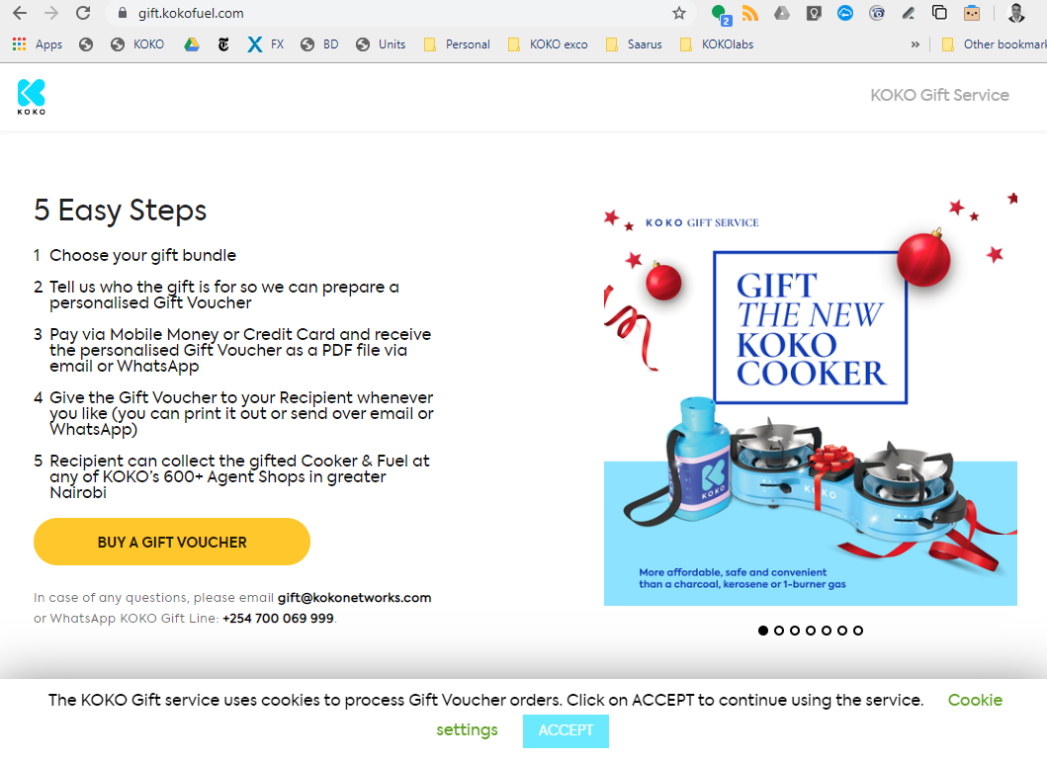

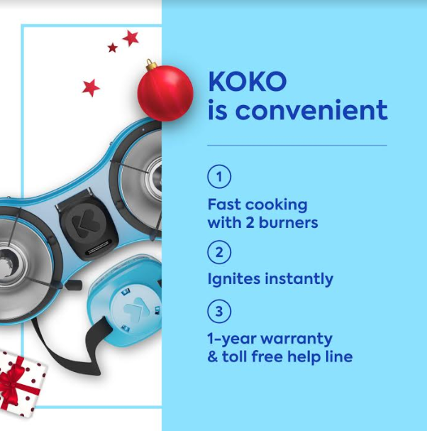
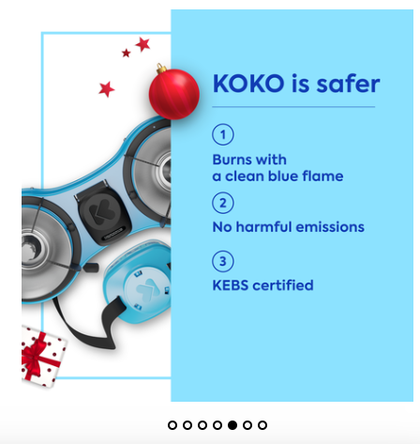
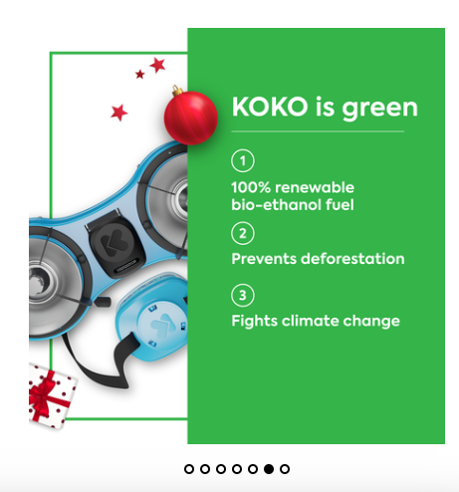
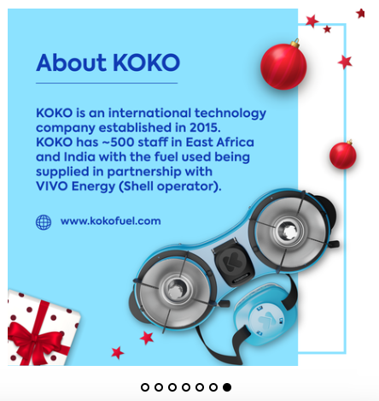
Website: gift.kokofuel.com | Home page

Slide 11
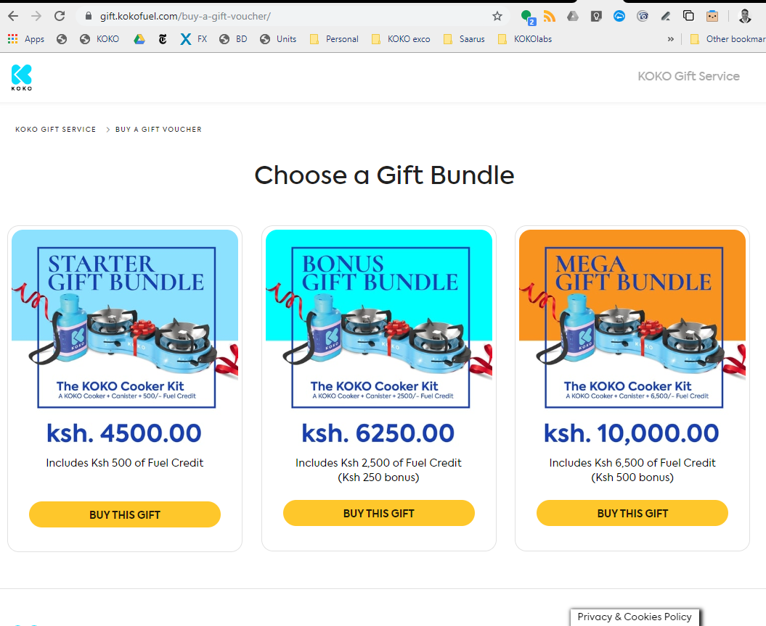
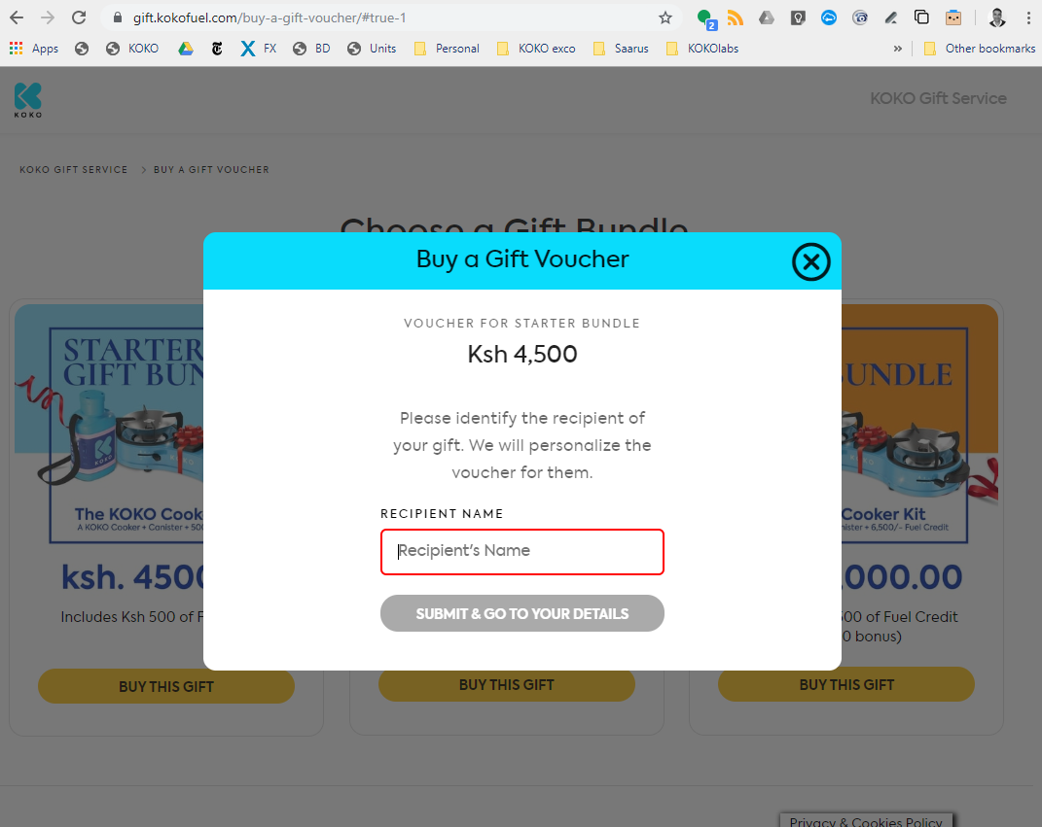
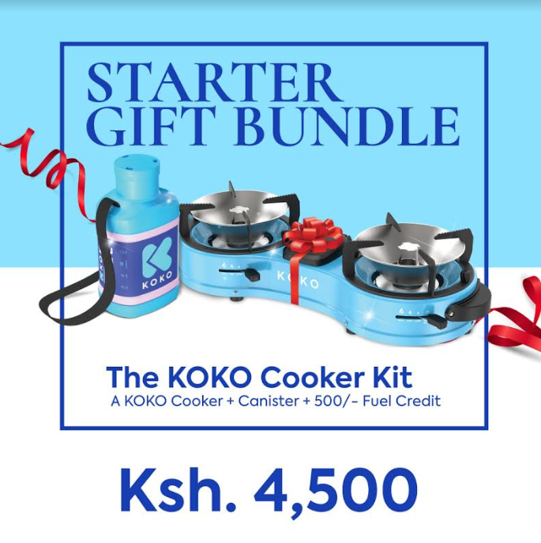


Website: gift.kokofuel.com | Buy a Gift Voucher page

Slide 12
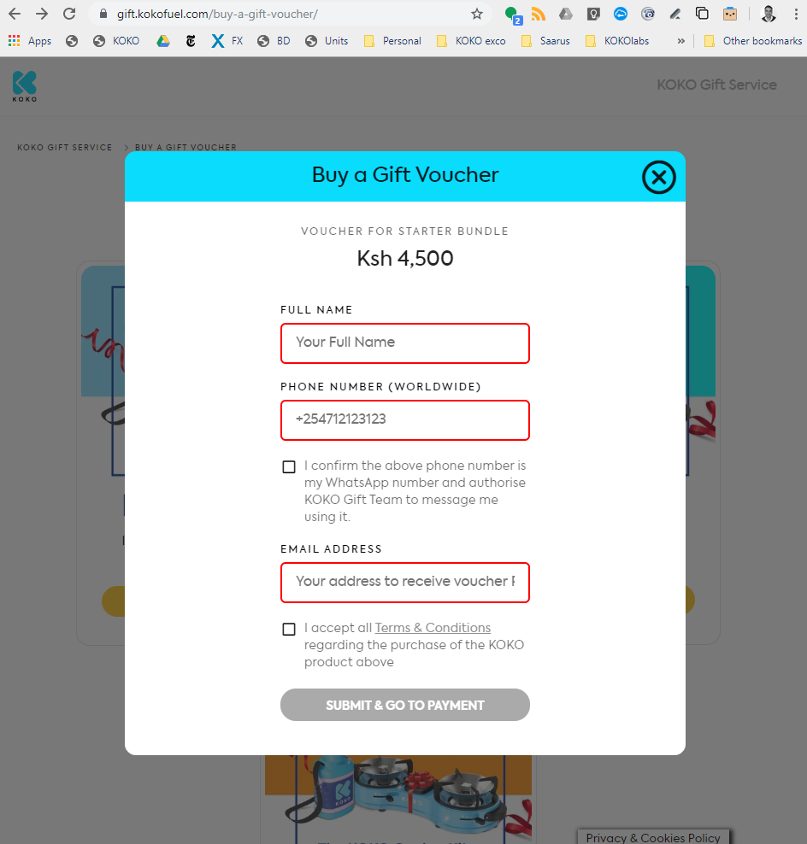
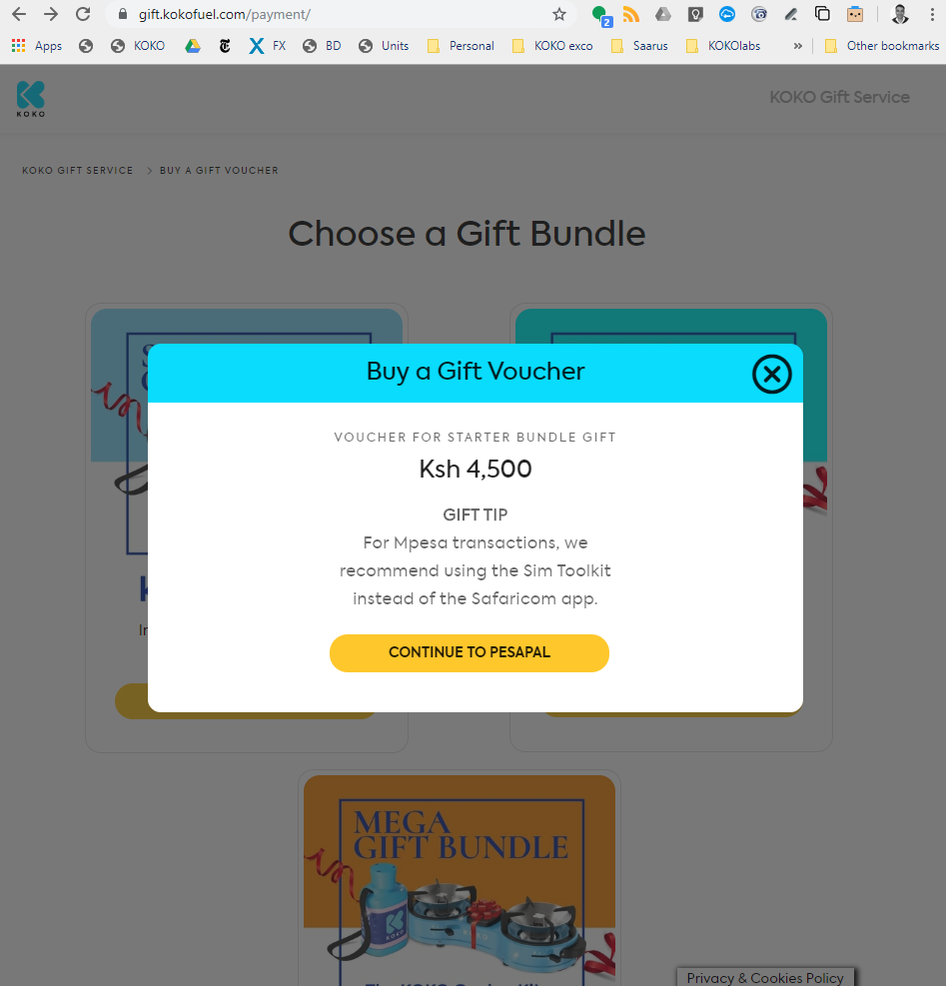
Website: gift.kokofuel.com | Buy a Gift Voucher page 2
T&C
page

Slide 13
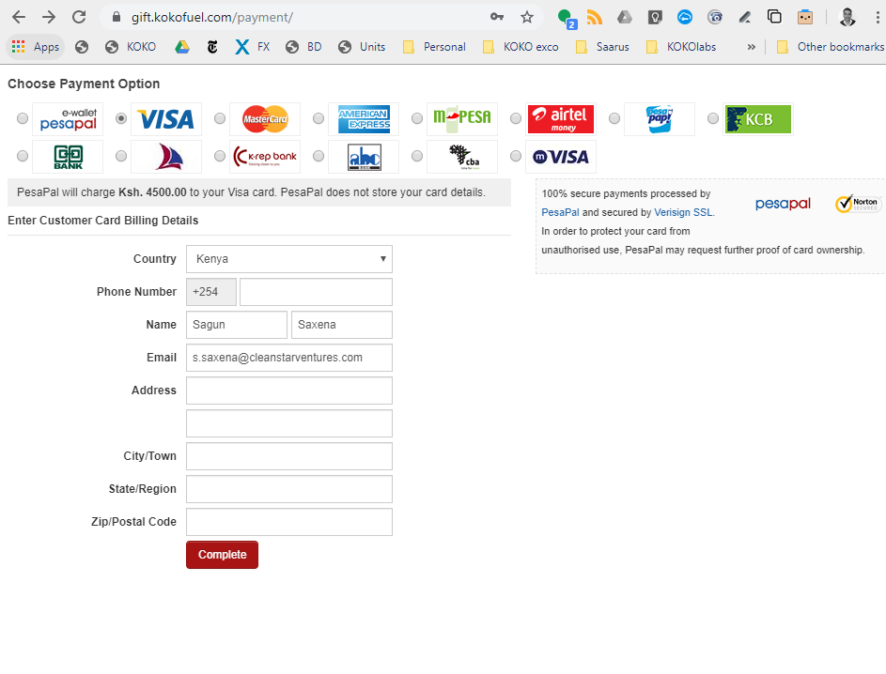
Website: gift.kokofuel.com | Payment page

Slide 14
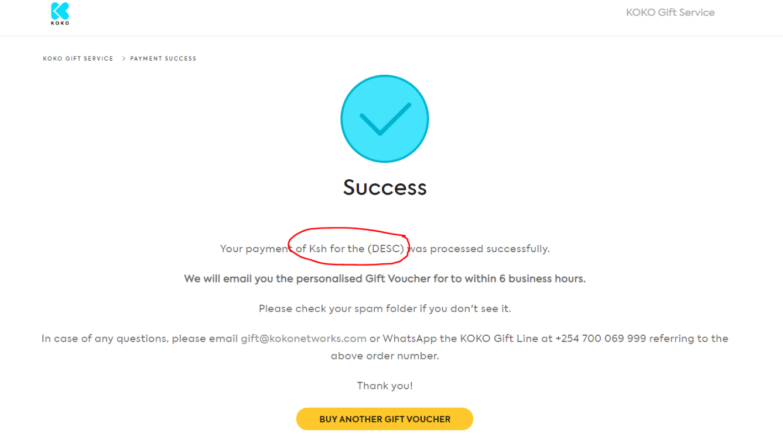
Website: gift.kokofuel.com | Payment page 2
To be added

Slide 15
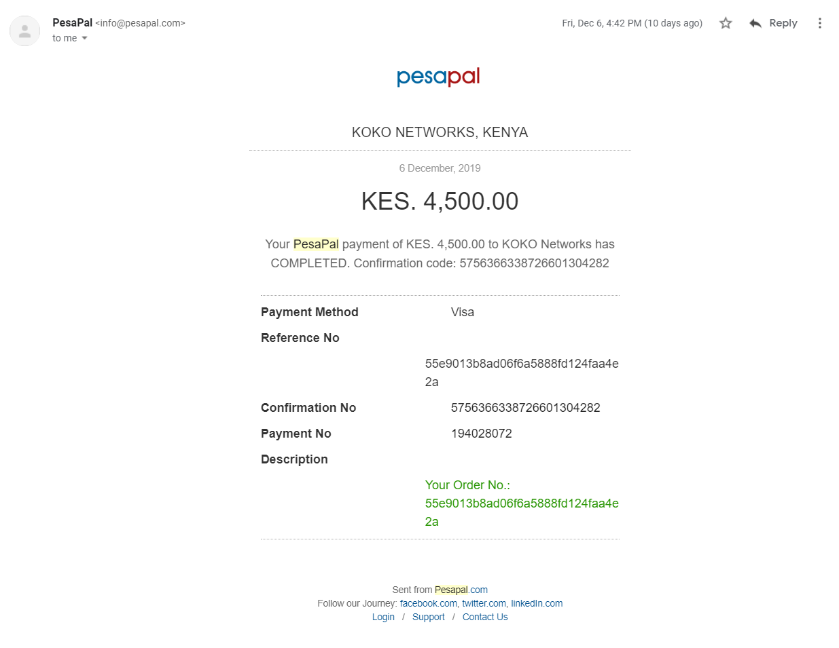
Website: gift.kokofuel.com |
Confirmation Email Sent by Pesapal to Gifter
Automatically generated by PesaPal
Latest version to be added here:

Slide 16
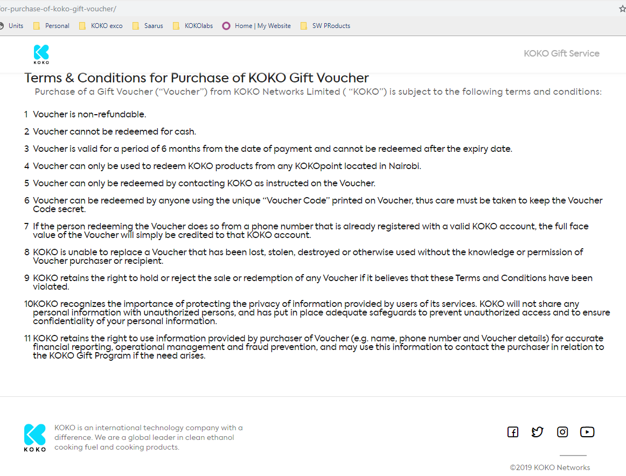
Website: gift.kokofuel.com | T&C page

Slide 17
Contents
Nomenclature
Overview of Gifting Process (3 slides)
Screenshots of final Gift Website, Emails, Voucher (& Whatsapp TBC)
Detail walk through of “1. Voucher Issuance Process”
Detail walk through of “2. Voucher Redemption Process”
FAQs - open issues

Slide 18
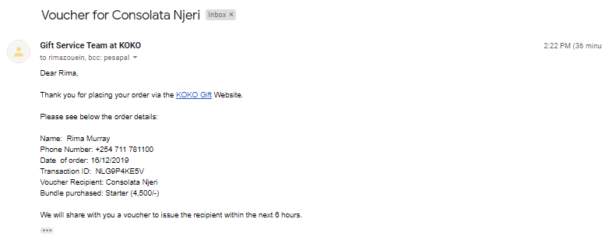
Auto/manual Email confirmation sent to Gifter
(sent from gift@kokonetworks.com)
Proposed Updated text for email:
Subject (to keep same thread as email containing Voucher PDF):
KOKO Voucher for [Recipient]
Text:
Dear [Gifter],
Thank you for ordering a Gift Voucher from KOKO.
Here are the order details for your information:
[…. ]
Your order will be processed and a personalised Gift Voucher sent to you within 6 business hours.
Should you have any questions, feel free to reply to this email or Whatsapp us at +254 700 069 999.
Thank you for using the KOKO Gift Service!
To place another order visit http://gift.kokofuel.com

Slide 19
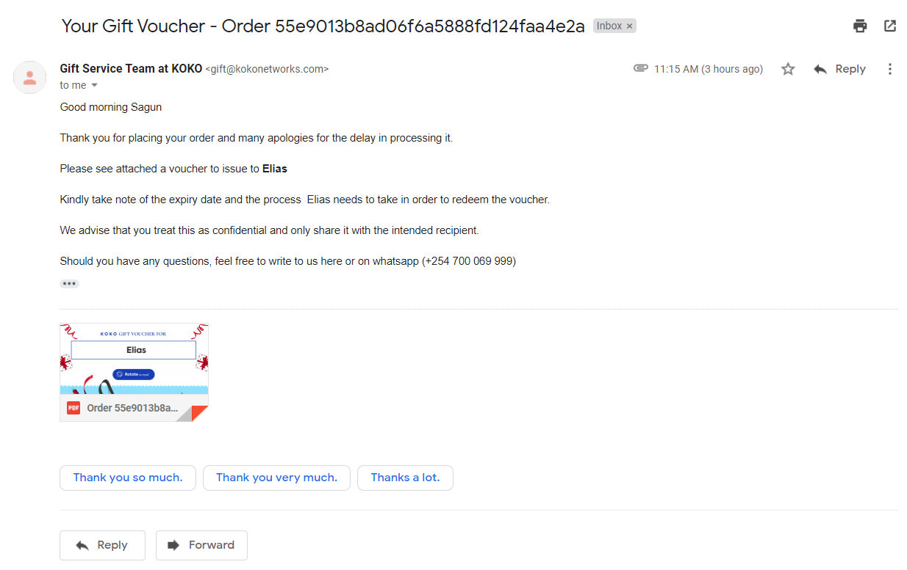
Manual Email sent to Gifter along with Voucher (sent from gift@kokonetworks.com)
Proposed UPdatd text for email:
Subject:
KOKO Voucher for [Recipient]
Text:
Dear [Gifter],
Attached is the KOKO Gift Voucher for [Recipient].
You can now share this Voucher directly with them over Whatsapp or after printing out.
The Voucher contains a unique Voucher Number (which should be kept secret) and important instructions for the Recipient to redeem your gift.
Should you have any questions, feel free to reply to this email or Whatsapp us at +254 700 069 999.
Thank you for using the KOKO Gift Service!
To place another order visit http://gift.kokofuel.com

Slide 20
Contents
Nomenclature
Overview of Gifting Process (3 slides)
Screenshots of final Gift Website, Gift Voucher (& Whatsapp TBC)
Detail walk through of “1. Voucher Issuance Process”
Detail walk through of “2. Voucher Redemption Process”
FAQs - open issues

Slide 21
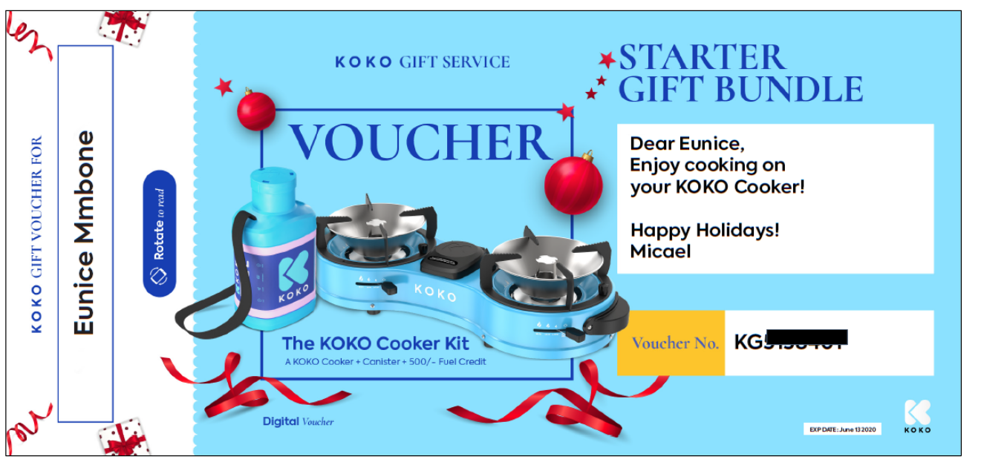
Voucher PDF: Page 1
(version shared by Max on 13 Dec)

Slide 22
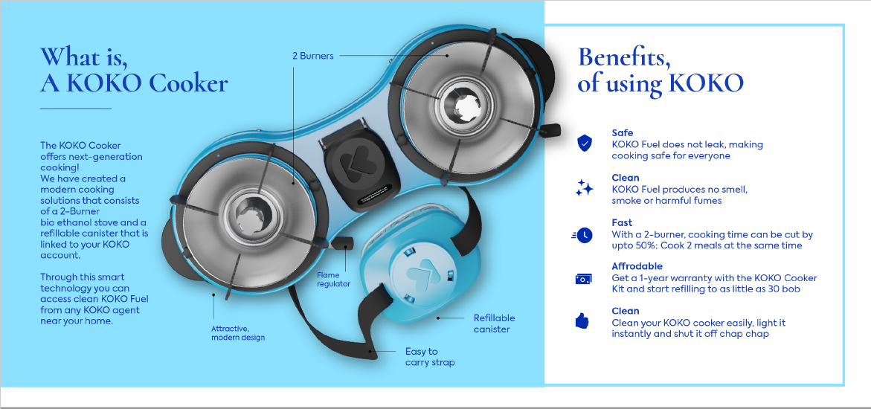
Voucher PDF: Page 2

Slide 23
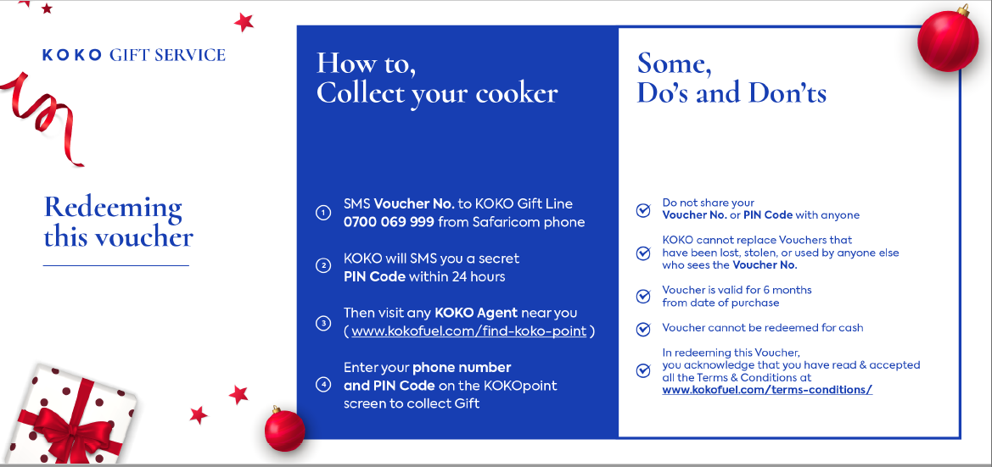
Voucher PDF: Page 3
Add in Kiswahili

Slide 24
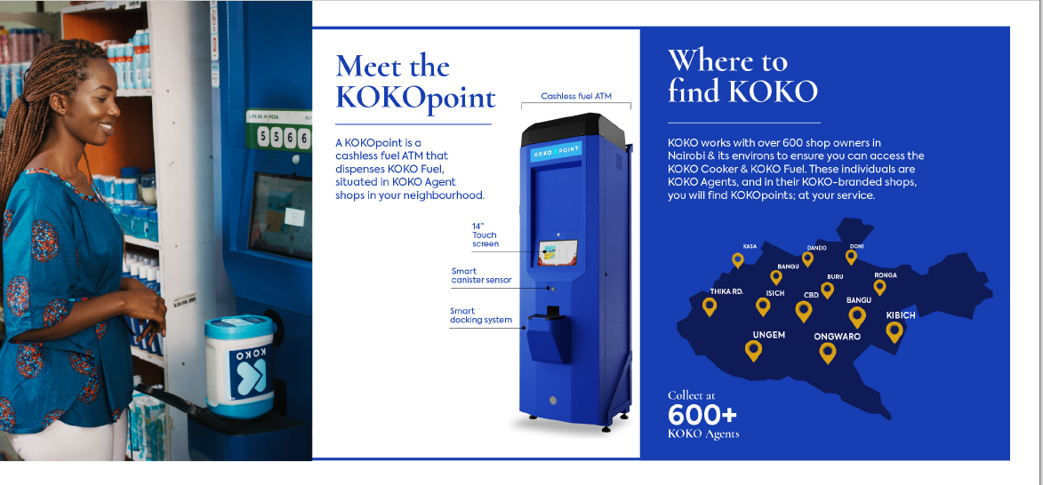
Voucher PDF: Page 4

Slide 25

Voucher PDF: Page 5

Slide 26
Contents
Nomenclature
Overview of Gifting Process (3 slides)
Screenshots of final Gift Website, Gift Voucher (& Whatsapp TBC)
Detail walk through of “1. Voucher Issuance Process”
Detail walk through of “2. Voucher Redemption Process”
FAQs - open issues

Slide 27
1. Voucher Issuance Process : Detailed Walkthrough
Response to gifter
2. KOKO receives order details on gift@kokonetworks.com & payment details on pesapal@kokonetworks.com
1.Gifter places order on GIFT KOKO website or Whatsapp
3. KOKO sends Email to GIFTER Confirming receipt of their order.
5. Add required details on the voucher (Voucher No. Message ,Expiry Date & Recipient name)
4. Order with a unique code KGxxxxx. Details to be filled on the Gift KOKO Order Log
6. Email/Whatsapp Gifter the voucher with details for redeeming
Response to gifter, along with voucher
QC before voucher is sent out:
Mercy & Rono

Slide 28
Contents
Nomenclature
Overview of Gifting Process (3 slides)
Screenshots of final Gift Website, Gift Voucher (& Whatsapp TBC)
Detail walk through of “1. Voucher Issuance Process”
Detail walk through of “2. Voucher Redemption Process”
FAQs - open issues

Slide 29
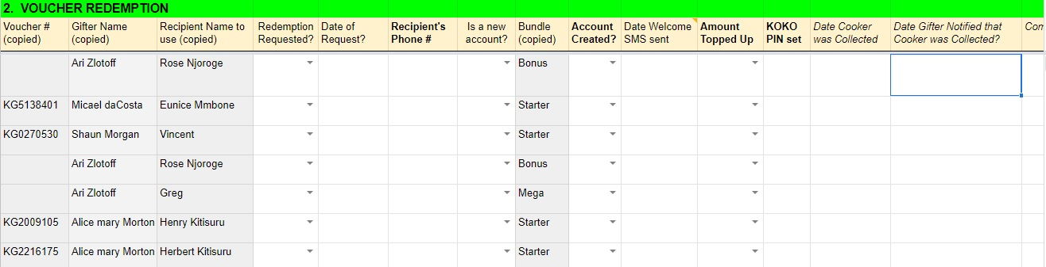
Voucher Validation
Recipient Sends SMS or Whatsapp to Gift Line with their Voucher Number
Verify and validate customer info/update gift order processing log with missing recipient details

Slide 30
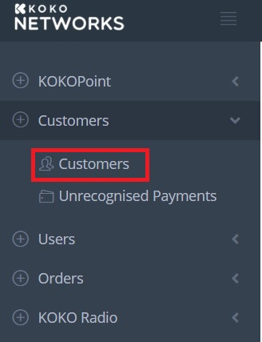
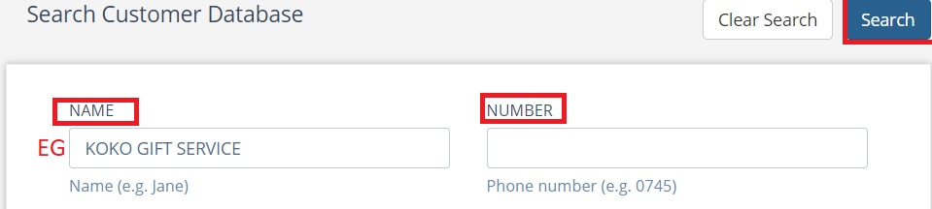
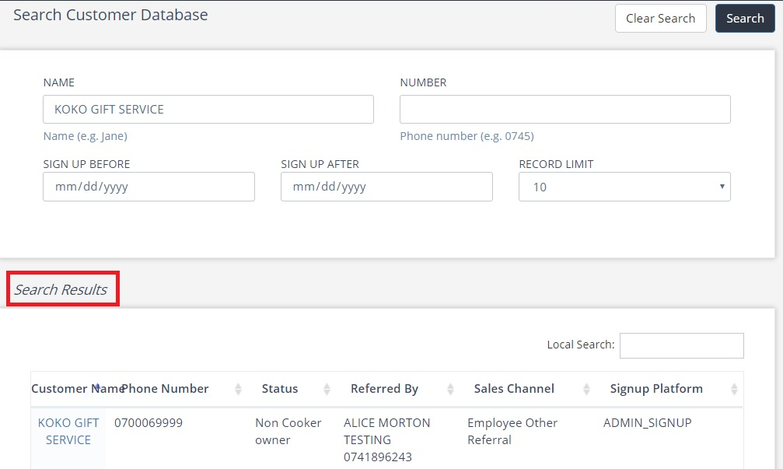
Search if customer exists in KOKO Core
Go to Customers>>Add Number or Name>> Search. (An account with customer details will show on search results if they exist, or none if they don’t)
1
2
3

Slide 31
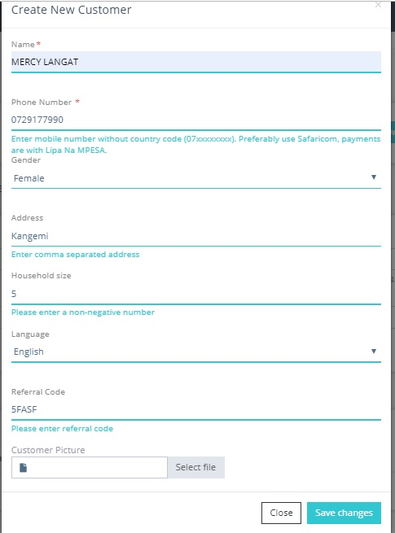
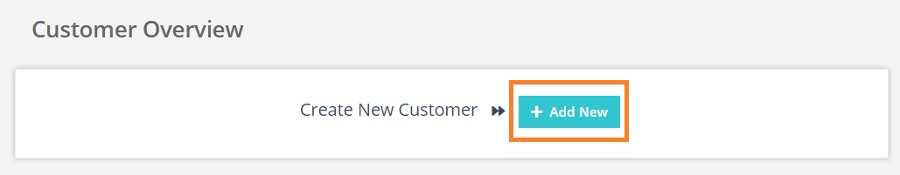
Create new customer account
1
3
2

Slide 32
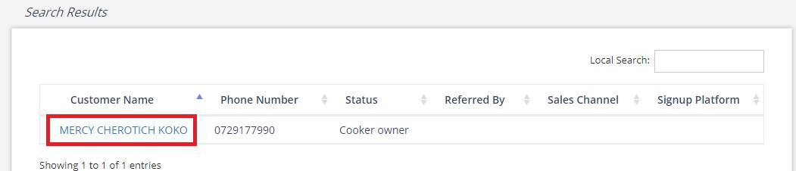
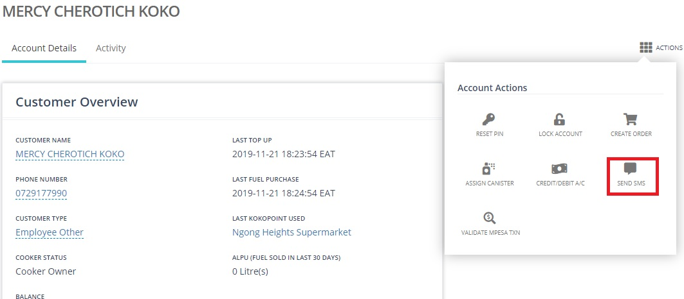
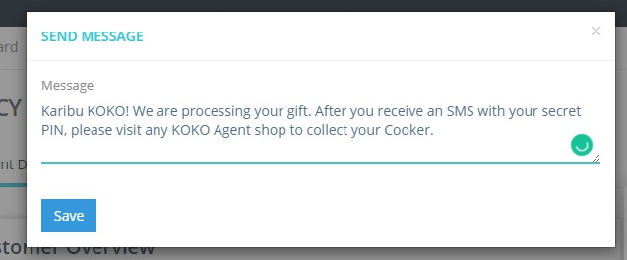
Send Welcome SMS
1
2
3

Slide 33
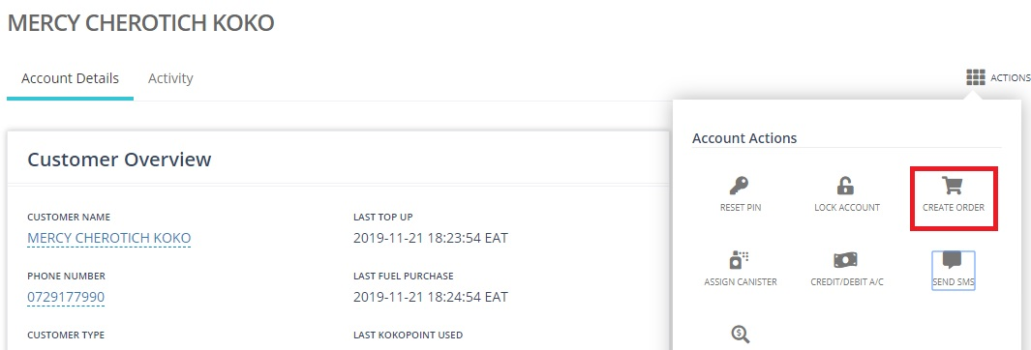
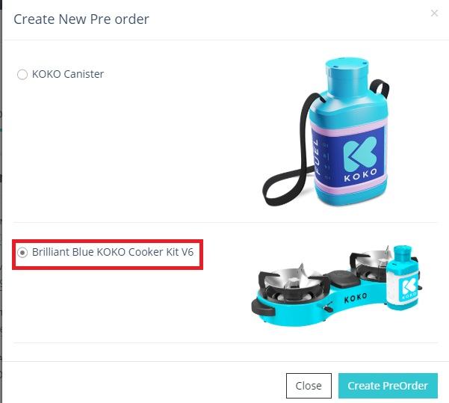
Create Pre-Order
1
2

Slide 34
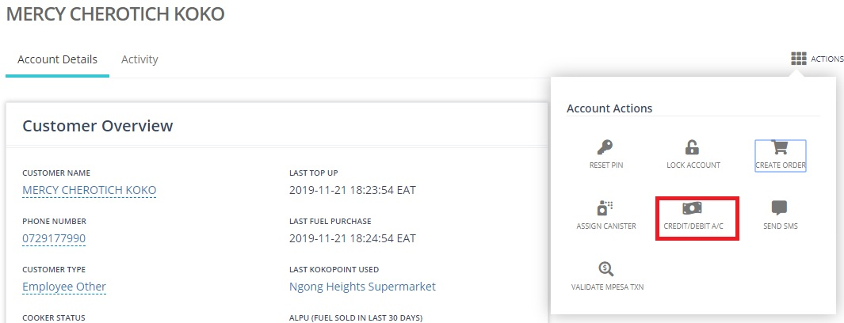
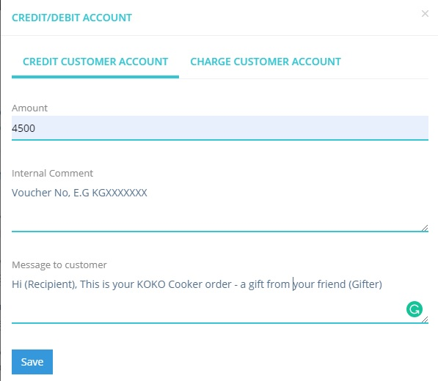
Credit Account
1
2

Slide 35
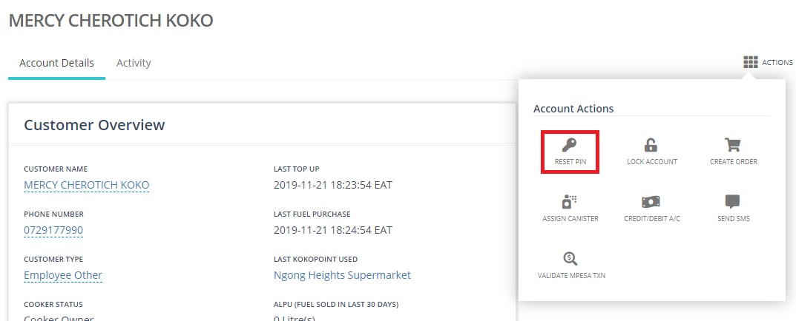
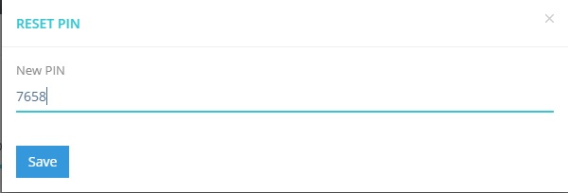
Reset PIN
1
2

Slide 36
Accounts Crediting Guide
BUNDLE | DESCRIPTION | AMOUNT TO CREDIT (KOKO CORE)
Starter | 4,500 (Includes Ksh 500 of fuel credit) | 4,500
Bonus | 6,250 (Includes Ksh 2, 500 of fuel credit - Bonus Ksh 250) | 6,500
Mega | 10,000 (Includes Ksh 6, 500 of fuel credit - Bonus Ksh 500) | 10,500

Slide 37
KOKO CORE PERMISSIONS
Send SMS
Reset PIN
Credit Account
Edit Referral Code

Slide 38
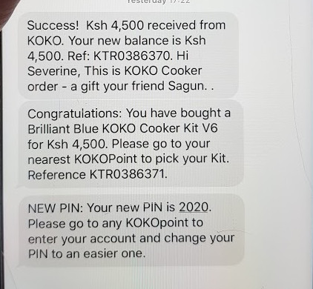
[add welcome Gift Service SMS before this]
TO BE ADDED:
Numbered steps for exactly what needs to be done

Slide 39
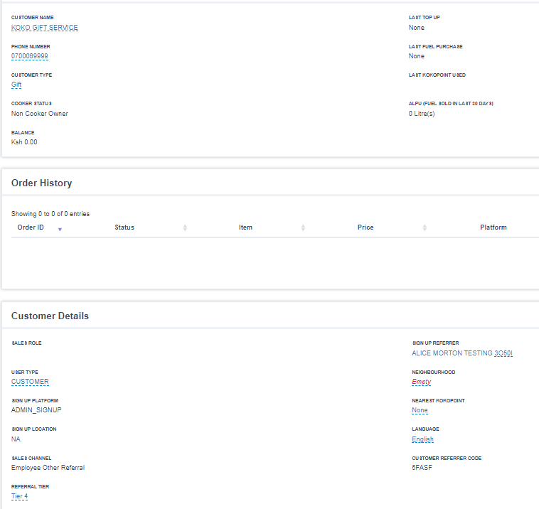
In creating all Recipient accounts,
for SIGN UP REFERRER enter KOKO Gift Service (REFERRAL CODE: 5FASF )

Slide 40
Contents
Nomenclature
Overview of Gifting Process (3 slides)
Screenshots of final Gift Website, Gift Voucher (& Whatsapp TBC)
Detail walk through of “1. Voucher Issuance Process”
Detail walk through of “2. Voucher Redemption Process”
FAQs - open issues

Slide 41
FAQ for Gifters : Master list
Can I get a refund on Gift Voucher I bought but did not send?
Lost Gift Voucher file / Can you please resend it?
Rono to update

Slide 42
FAQ for Recipient: Master list
xxx

Slide 43
FAQ for Gift Team: Master list
What if Recipient already has a KOKO Account ?

Slide 44
ARCHIVED SLIDES GO HERE

